Slide 1


Introduction to Machine Learning Part 1: Roadmap and basic concepts
Jaume Bacardit
Interdisciplinary Computing and Complex BioSystems (ICOS) research group, School of Computing, Newcastle University
Jaume.Bacardit@Newcastle.ac.uk
Twitter: @jaumebp

Slide 2
About me
Reader in Machine Learning at Newcastle University
Did my PhD in Machine Learning
Moved towards the analysis of bio data from my postdoc onwards
Interests:
Big Data
Algorithmic Knowledge Extraction techniques
Applied Machine Learning

Slide 3
Machine Learning
“Programs that automatically learn from experience” (Tom Mitchell, 1997)
A computer program that based on the ratings you give to movies, can recommend you new movies to see
Almost total overlap with data mining “The extraction of knowledge from large amounts of data” (Han and Kamber, 2006)
Difference is perception (focus on methods, or focus on problem)

Slide 4
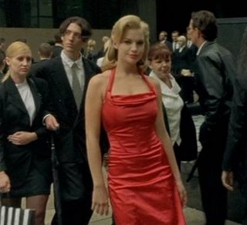
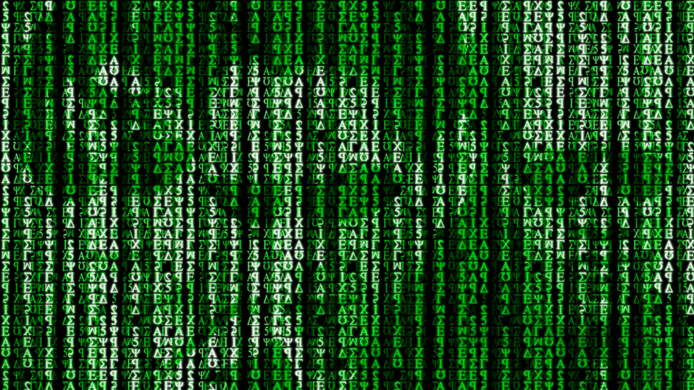
Remember The Matrix?

Slide 5
What do you see in here?
If att3<1.257 and att4>1.741 then predict 3
If att3>1.746 and att4<1.252 then predict 3
If att3>1.748 and att4 in [1.495,1.771] then predict 3
If att3 in [1.487,1.750] and att4 in [1.248,1.504 then predict 3
If att3<1.263 and att4 in [1.250,1.487] then predict 3
If att3 in [1.250,1.515] and att4<1.258] then predict 3
If att3 in [1.501,1.746] and att4>1.743] then predict 3
If att3 in [1.249,1.499] and att4 in [1.497,1.752] then predict 3
If att3<1.250 and att4 in [1.250,1.507] then predict 3
Anything else -> predict 2
. . .

Slide 6
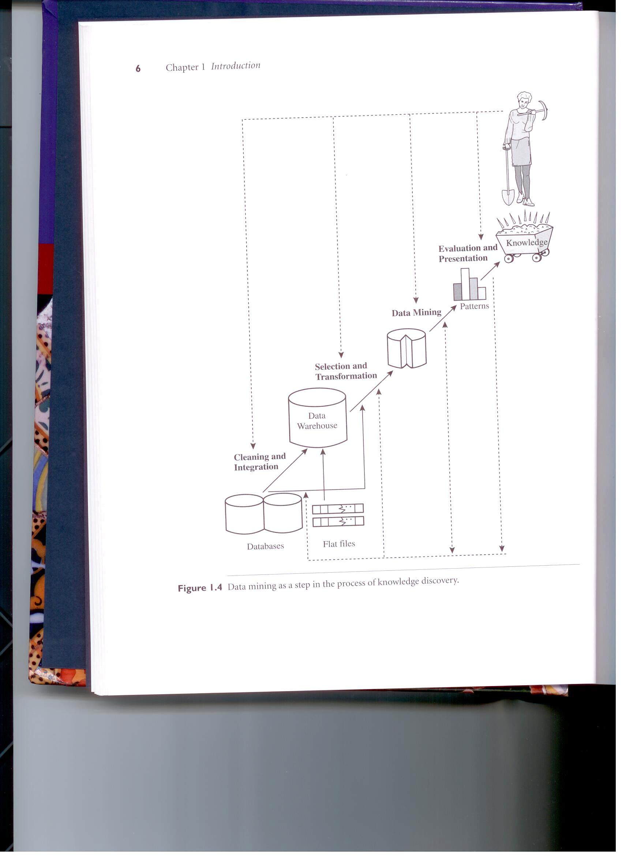
The life cycle of machine learning
ML requires a suitable analysis pipeline
Getting and understanding the data
Having the suitable infrastructure to handle your data
Transforming it so it is ready for analysis
Analysing the data to extract useful information
Post-processing and visualising the extracted knowledge
The central part of this pipeline (transformation and analysis) is what, in a broad sense, is called machine learning
(Han and Kamber, 2006)

Slide 7
Roadmap
Lecture 1: Introduction and nomenclature
Lecture 2: Evaluation protocols
Lecture 3: Standard Machine Learning algorithms
Lecture 4: Evolutionary Machine Learning
Lecture 5: Neural Networks principles
Lecture 6-7: Deep Learning
Lecture 8: Data preprocessing
Lecture 9: Scalability

Slide 8
Dataset structure
In most cases we will treat a dataset as a table with rows and columns
Many exceptions to this rule in the deep learning topic
When data gets to the ML algorithms, these don’t really care or know what was its origin, or whether there is some background domain knowledge. They just work with what is given, the instances and attributes.
Attributes
Instances

Slide 9
Instances and attributes
Instances are the atomic elements of information from a dataset
Also known as records or prototypes
Each instance is composed of a certain number of attributes
Also known as features or variables
In a dataset attributes can be of different types
Continuous (or Integer)
Discrete (i.e. being able to take a value from a finite set)

Slide 10
Learning tasks
Supervised learning
Classification
Regression
Unsupervised learning
Clustering
Association Rule Mining
Reinforcement learning

Slide 11
Supervised Learning
X
Y
To train a program that learns to estimate Y from X
Why?
Y many be time-consuming/costly to generate
Y may be in the future
New
Instance
Training Set
Machine Learning
algorithm
Models
Inference Engine
Annotated Instance

Slide 12
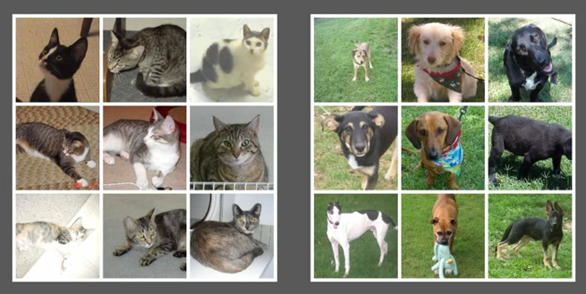
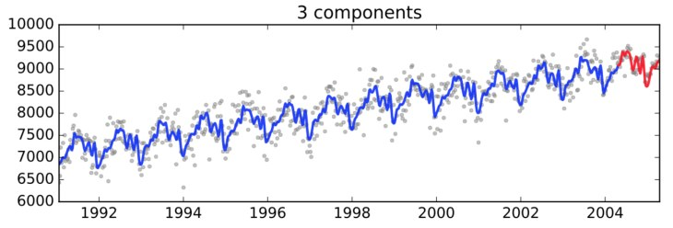
Types of supervised learning
If Y is discrete
We call it class
The dataset is a classification problem
If Y is continuous
We call it output
The dataset is a regression problem
Also called modelling or function approximation
Is it a cat or is it a dog?
Predict the next values of the times series

Slide 13
Unsupervised learning
When we do not have/not take into account the class/output attribute
If the goal is to identify aggregations of instances
Clustering problem
If the goal is to detect strong patterns in the data
Association rules/Itemset mining

Slide 14

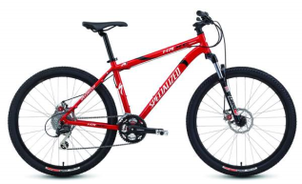
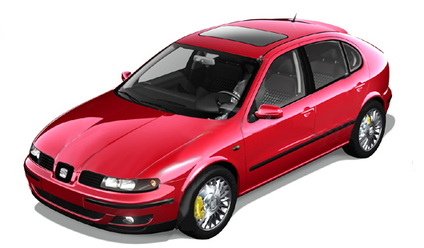

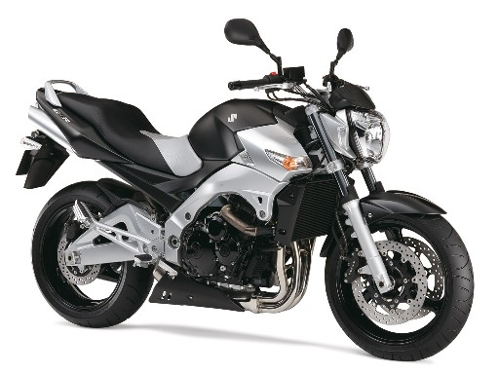

Clustering

Slide 15
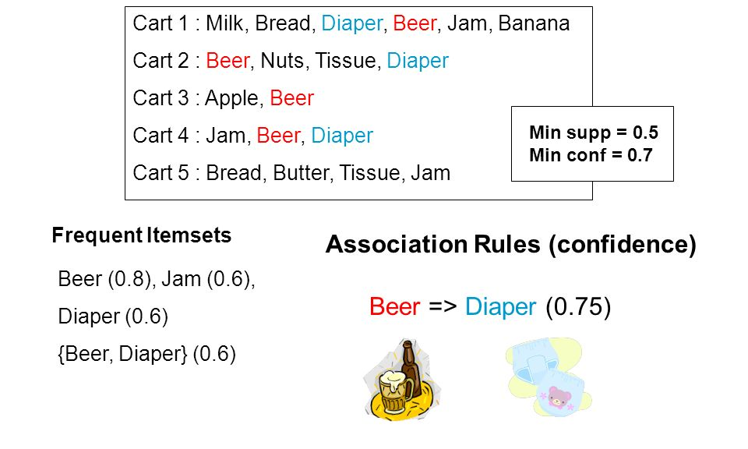
Association Rule Mining
Slide from https://slideplayer.com/slide/8628813/

Slide 16
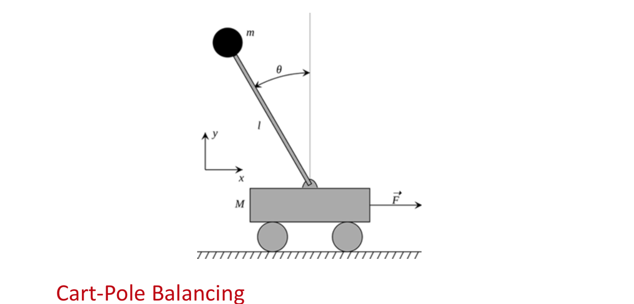
Reinforcement learning
Setup for agents that sense an environment and need to respond to it
After each action they receive either a reward or a punishment
They need to learn how to produce given each input state, the output that will produce the maximum (expected) payoff
Classic example
Modern example: AlphaGo
https://en.wikipedia.org/wiki/Inverted_pendulum

Slide 17
Knowledge representations
What shape do the “patterns” take?
This is what is called knowledge representation
There are lots of them
Basic: Rule sets, decision trees, nearest neighbours, linear classification
Advanced: Kernel methods, Neural Networks (soon)

Slide 18
Rule sets & decision trees
What it represents
Model
1
Node = {
isLeaf?: bool
classLabel: int
attributeID:int
threshold:float
leftBranch:Node
rightBranch:Node
}
X
X<0.5
X>0.5
Y
Y
Y<0.5
Y>0.5
0
X
1
1
If (X<0.25 and Y>0.75) then →
If (X>0.75 and Y>0.75) then →
If (X<0.25 and Y<0.25) then →
Everything else →
Y
Rule set = {<list of rules>, default class}
Rule = {<list of predicates>, predicted class}
Predicate = {attributeID, lower bound, upper bound}
Default rule
0
1
X

Slide 19
Nearest-neighbour classifier
Classify new instance based on the training example(s) more similar to the new instance
If k examples are retrieved (k-NN), prediction is a majority vote of the k most similar instances
Model
1
(-0.125,0,yellow)
(0.125,0,red)
(0,-0.125,blue)
(0,0.125,green)
Y
0
1
X

Slide 20
Linear Classification
Knowledge representation defined a line (in general an hyper-plane).
Line separates instances from different classes
Output = X•W + b
(scalar product between the vector X that defines an input instance and the vector W that defines the hyperplane)
If Output>0 → predict X
Else → Predict O
x
x
x
x
x
x
x
x
o
x
Model = (W,b) plus what class is on each side
o
x
o
o
o
o
o
o
o
o
o
o
o

Slide 21
Search mechanisms
The knowledge representation just specifies what shape would the patterns have
It does not actually look for the patters in the data
The search mechanisms are in charge of this
Many biologically-inspired algorithms are ideal for this task
Often non-biologically-inspired methods are also used: e.g. gradient descent
In some cases (e.g. building decision trees) greedy heuristics are used

Slide 22
Machine Learning bias: A simple example
Image you want to train an image classifier that discriminates cats from dogs
You feed it the set of images to the right
Do you notice something in them?
In reality your algorithm is learning a different task: discriminating indoor/outdoor
From “Machine Learning Gremlins” by Ben Hamner https://www.youtube.com/watch?v=tleeC-KlsKA

Slide 23

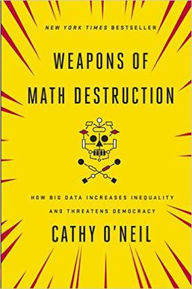
When ML predictions go wrong….
It is not just about social media sites. It affects the lives of people: https://www.npr.org/sections/alltechconsidered/2018/02/19/586387119/automating-inequality-algorithms-in-public-services-often-fail-the-most-vulnerab
And many more: “Investigating Algorithmic Injustice” blog https://www.propublica.org/series/machine-bias
What is the problem? Algorithms are biased because the training process/data did not reflect the full complexity of the real world.

Slide 24


When ethics are embedded in the ML applied research. Case study: the APPROACH project
APPROACH is a €15M EU-funded biomedical project focusing on a particular disease: Osteoarthitis
Machine Learning is used to recruit patients for the study from historical data
Two sets of ML models
To decide who to call to a screening visit
Who to enroll in the study
Ethical considerations
Historical data is anonymized. We cannot link pre and post-screening data (so we can’t check if our models are correct)
To be selected in the study implies fast progression in the disease. How patients are going to feel about it? → Patient council

Slide 25
Readings
Tom M. Mitchell, Machine Learning, McGraw-Hill, 1997
I Witten, E. Frank and Mark. A. Hall, Data Mining - Practical Machine Learning Tools and Techniques, third edition, Elsevier, 2011
J. Han and M. Kamber, Data Mining, Conceptes and techniques, Elsevier, 2006
Trevor Hastie, Robert Tibshirani and Jerome Friedman, The Elements of Statistical Learning, 2nd ed., Springer, 2009

